Slide 1
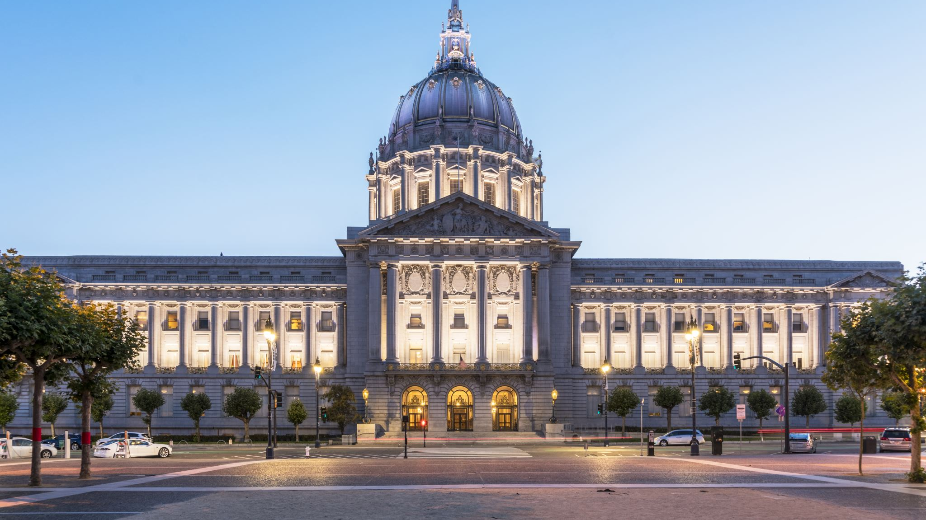
What affects consumer sentiment?
Stanley Evans
Data Science Practicum I
Regis University | Denver, CO
December 9th, 2021

Slide 2
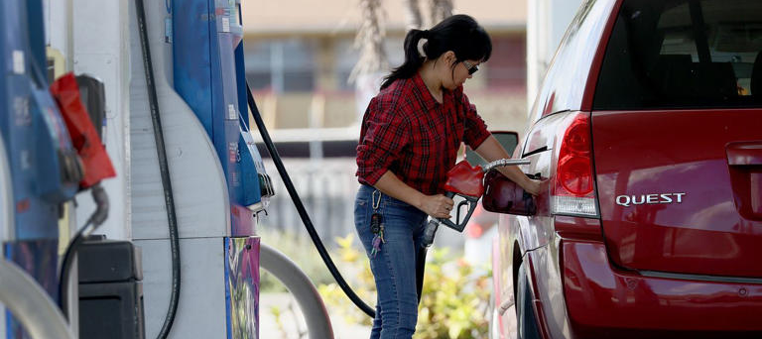

Is inflation the main culprit of how we feel about the economy?

Slide 3
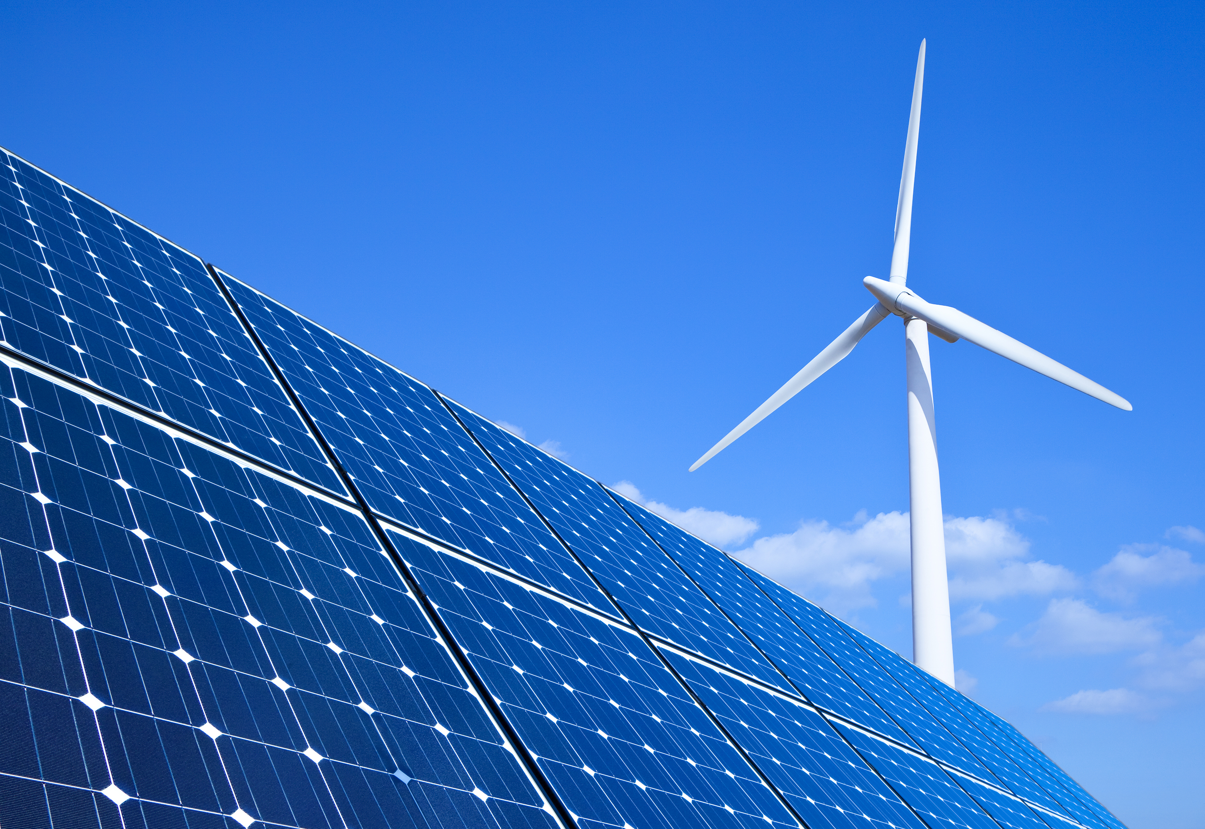

What is consumer sentiment?
“Consumer sentiment is an economic indicator that measures how optimistic consumers feel about their finances and the state of the economy.”
-(Liberto, 2010)

Slide 4
Through the years
trends flat

Slide 5
Project Walkthrough
Extract Pricing for:
Consumer Natural Gas & Electricity
University of Michigan
-
University of Florida
Complete wrangling, join, clean, EDA, Multiple Regression, ML
Energy Information Administration API
Consumer Sentiment
Join & Insights
Bureau of Labor Statistics
Inflation
Top consumer product segments from BLS
Historic Inflation rate monthly

Slide 6
Removal of S&P 500
The top 10% of income earners own 10 times as much of the stock market as the bottom 60%.
The average stock owner is most likely to be invested through mutual funds and retirement plans.
The stock market accounts for just 9% of the assets of the lowest-earning families

Slide 7
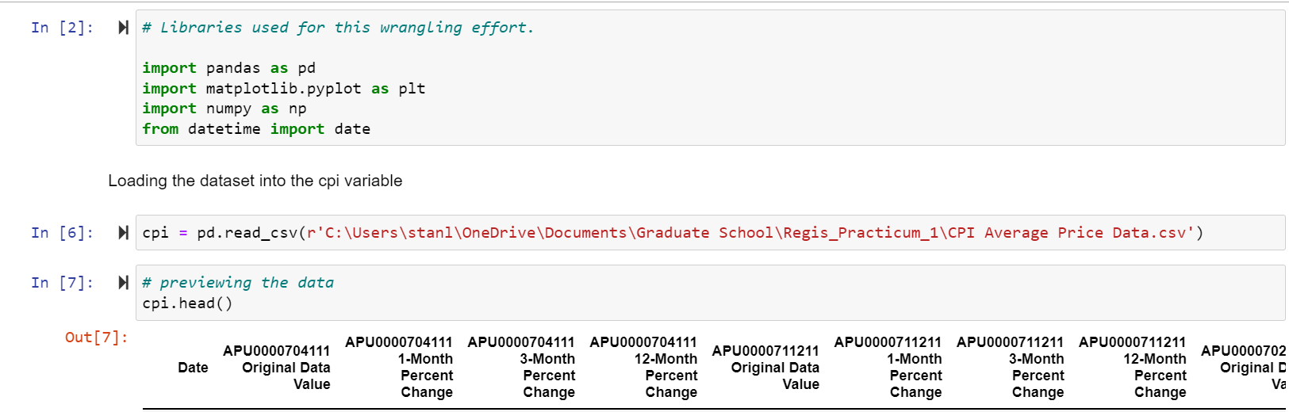
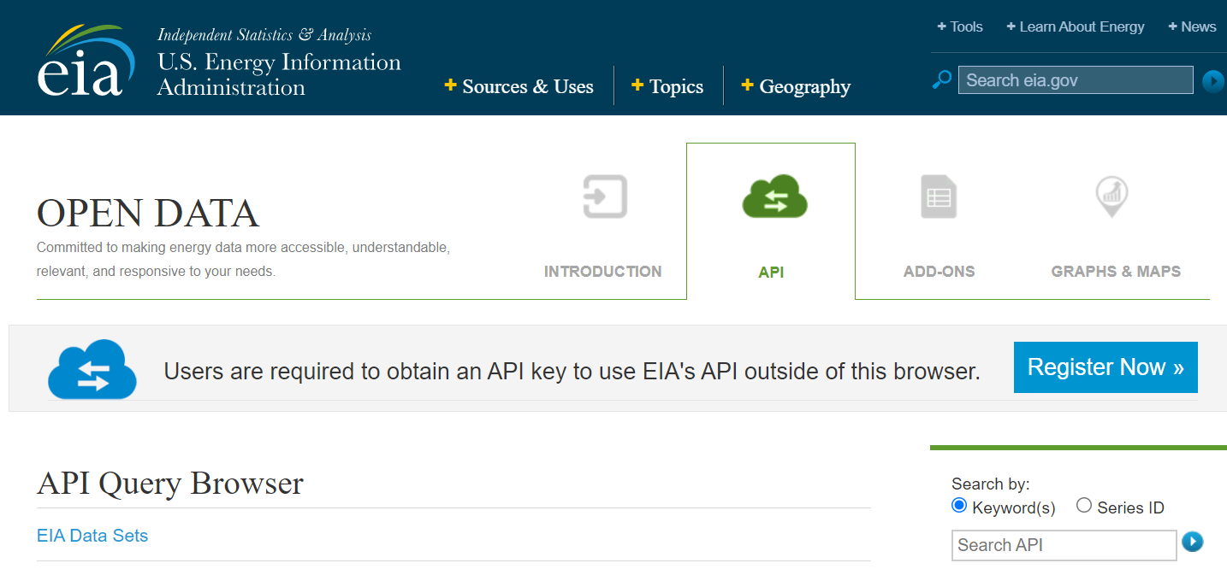
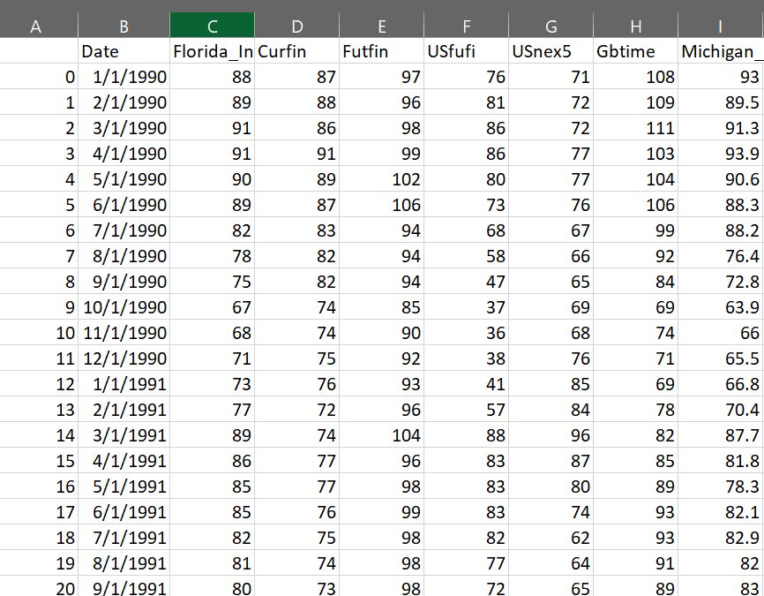
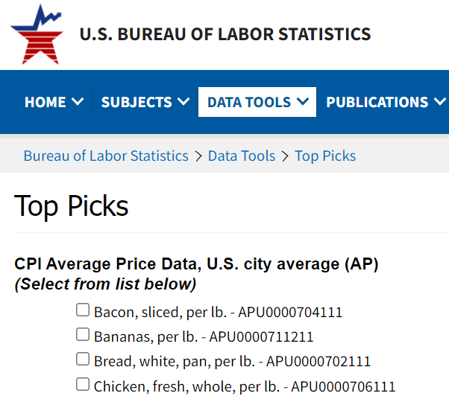
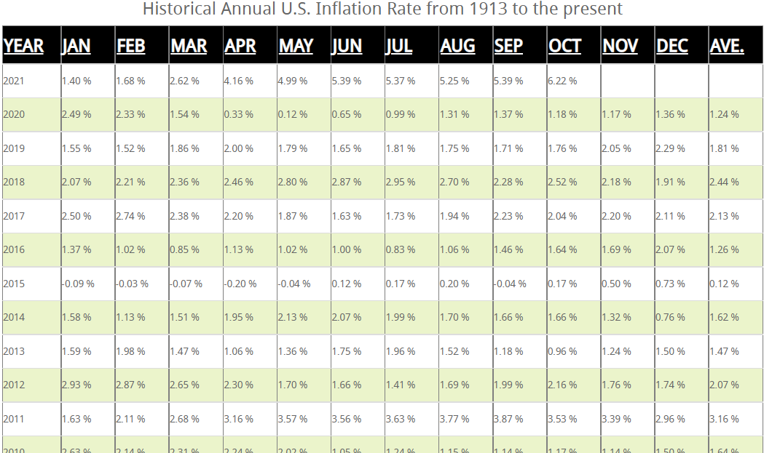


Excel Conversions
EIA Dataset is built within Python
Excel to Python
Consumer Price Index
Consumer Sentiment Survey
Historical Inflation

Slide 8
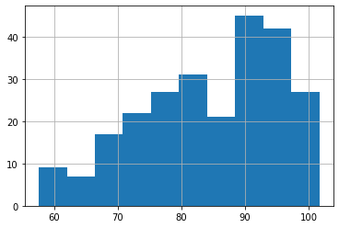
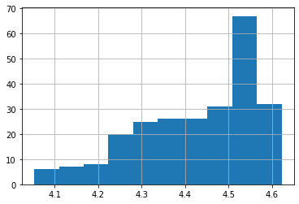
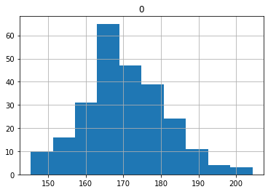
Normal vs Sentiment
Sentiment
After Log Transformation
Normal

Slide 9
Initial Findings
Negative to sentiment

Slide 10
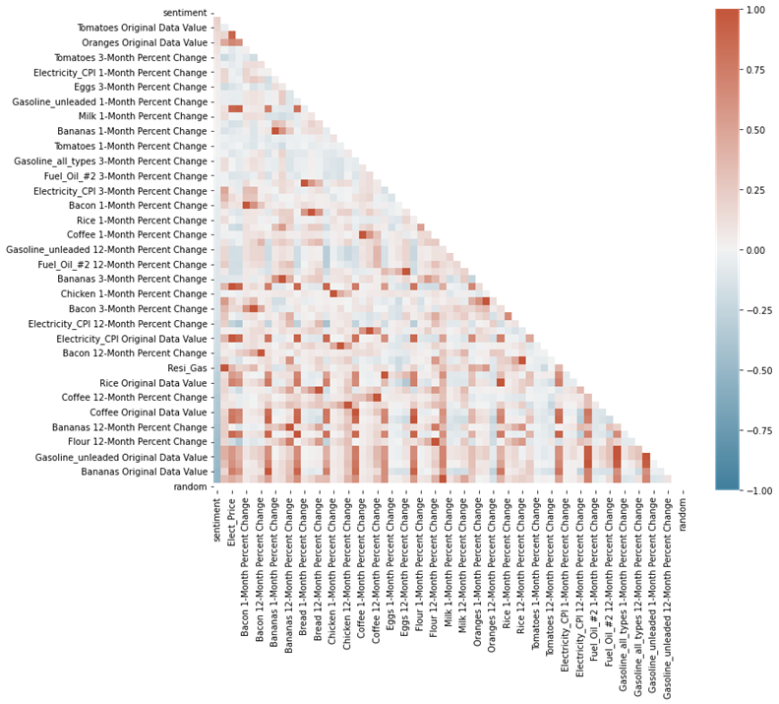
Heatmap
Color coded to show correlations
Inverse relationships
Negative is not bad
Multicollinearity is…
To drop or not to drop
VIF Test
Random Forest Regressor
Multicollinearity

Slide 11
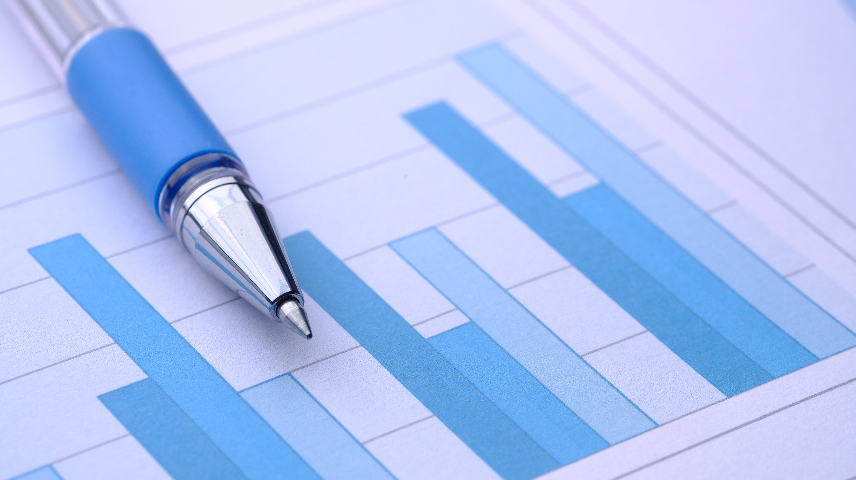
Multiple Regression Analysis
Evaluating the data

Slide 12
Multiple Linear Regression
Most Influential
Coefficients
Residential Natural Gas Price
Electrical Price
Bacon
Bananas
Bread
Chicken
Eggs
Inflation
-0.1166
0.2706
0.2178
-0.2587
-0.4809
0.1626
0.0871
0.0697
Notes:
Residential Natural Gas increases cause negative sentiment, as well as Bananas and Bread.
However surprisingly Inflation increases cause a positive increase in sentiment.
Surprising that gas unleaded prices and milk do not meet the .05 level.

Slide 13
Results of Multiple Linear Regression
P-value of F: 9.14e-78
Explained Variance
R² = 82.1%
Adj. R²= 81%
the proportion of the variance for a dependent variable that's explained by an independent variable(s) in the regression model.

Slide 14
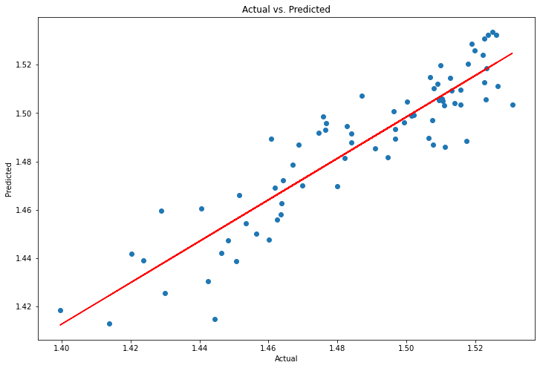
Predicted Result - Multiple Linear Regression
P-value of F: 9.14e-78
Explained Variance
R² = 82.1%
the proportion of the variance for a dependent variable that's explained by an independent variable(s) in the regression model.

Slide 15
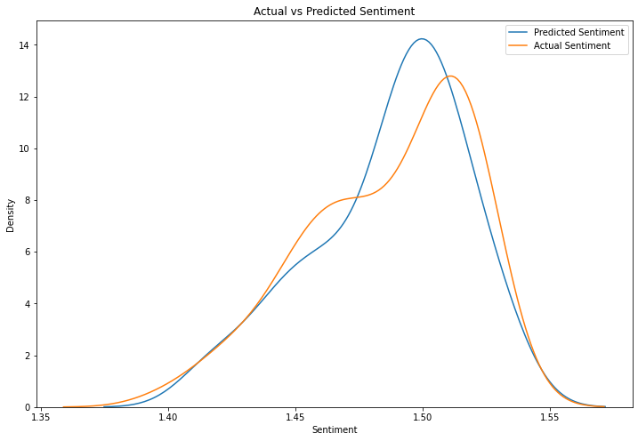
So how does it perform?
Notes:
Based on the explained variance we mentioned we see how accurate our model is to the actual results

Slide 16
Two-way ANOVA
Rejecting Null Hypotheses
Probability Values
There is no interaction between the Inflation and Gas variables.
There is!
The mean response is the same across Inflation
It is not
The mean response is the same across Gas Price
It is not
Inflation : Gas: 2.0159e-14
Inflation: .002849
Gas_Price: 4.095e-17

Slide 17
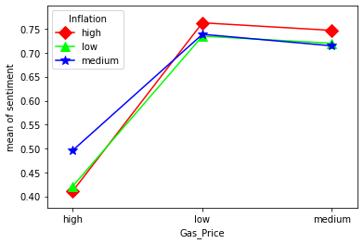
Two-Way ANOVA Interaction Plot
Findings…..
Inflation & Gas: 2.0159e-14
Inflation: .002849
Gas_Price: 4.095e-17
Interaction Points
Notes:
This number tests that there is NO interaction. BUT WE SEE…..
There is an interaction between the Inflation and Gas variables.
Probability that the mean response is the same across…..
The mean response is not the same across Inflation
Probability that the mean response is the same across…..
The mean response is not the same across Gas Price

Slide 18

Random Forest Regressor
Decision Tree Analysis

Slide 19
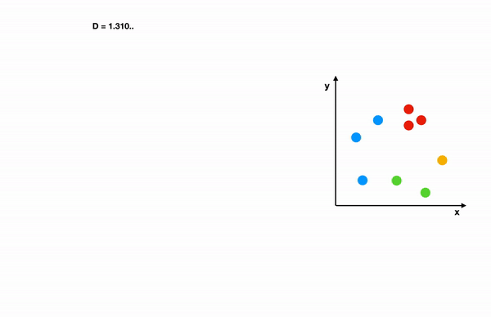
A quick walkthrough…
Predicts sentiments by sampling different paths to results
If milk was X then electricity is Y what we can predict the resulting sentiment is Z
Grigg, (2019)

Slide 20
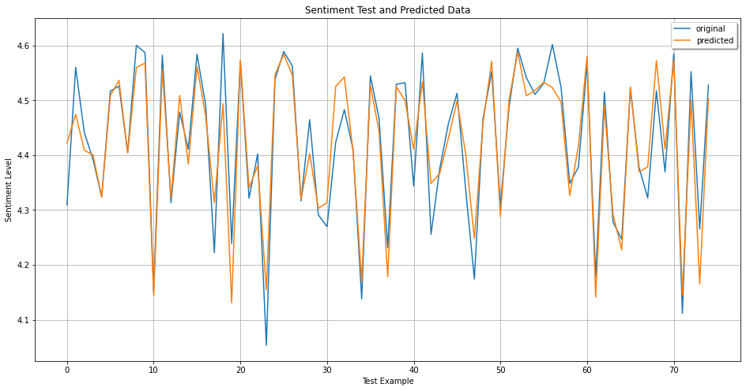
Sentiment vs Predicted
R-squared: 97.9%
MSE: 0.000112
RMSE: 5.62224e-05
Concerns…..
Overfit?
Create features from what exists
Remove further multicollinearity
More representation for other sectors

Slide 21
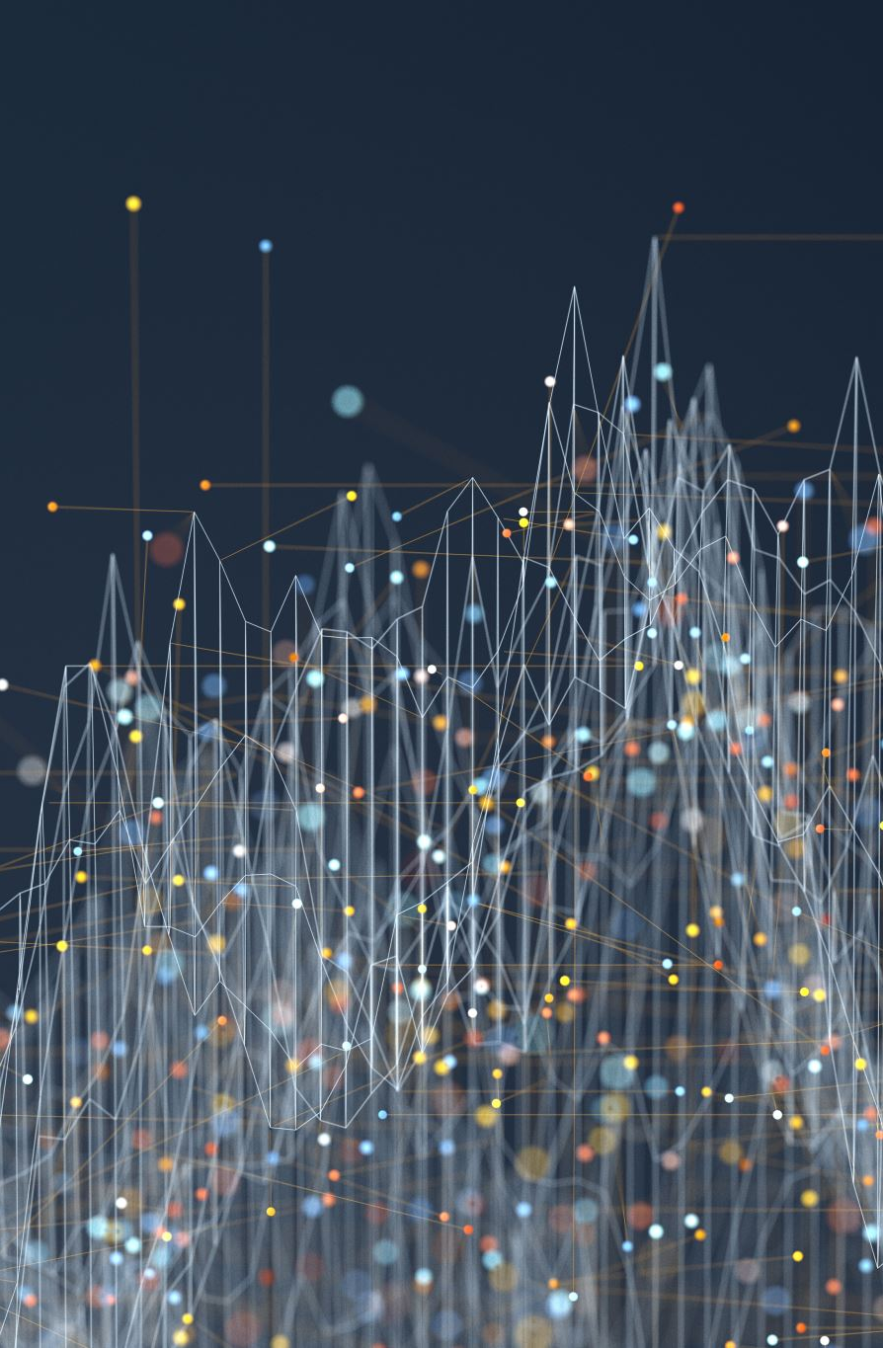
Conclusion
Inflation does play a role in how we feel about the economy.
However, it is not the main culprit of these feelings.
It is the everyday interactions with pricing of different products in our lives.
The sudden realization from media reports and surveys that remind us of the past.
But the past is relative. What were the features of life then?
Expand the study | combine features.

Slide 22

Thank You
Stanley Evans
sevans007@regis.edu
LinkedIn
GitHub

Slide 23
References
Grigg, T. (2019, April 8). Interpretability and Random Forests | by Tom Grigg | Towards Data Science. Medium; Towards Data Science. https://towardsdatascience.com/interpretability-and-random-forests-4fe13a79ae34
Liberto, D. (2010, October 25). Consumer Sentiment Definition. Investopedia; Investopedia. https://www.investopedia.com/terms/c/consumer-sentiment.asp
Matthews, C. (2021, November 24). Consumer sentiment at decade lows amid “rapidly escalating inflation,” UMich survey finds - MarketWatch. MarketWatch; MarketWatch. https://www.marketwatch.com/story/coming-up-umich-consumer-sentiment-survey-11637765079
USAFacts. (2021, March 2). What percentage of Americans own stock? - USAFacts. USAFacts; USAFacts. https://usafacts.org/articles/what-percentage-of-americans-own-stock/

